Slide 1



APIs

Slide 2
What is an API?
Application Programming Interface
A bridge between different software programs, it defines how they can communicate & share data

Slide 3
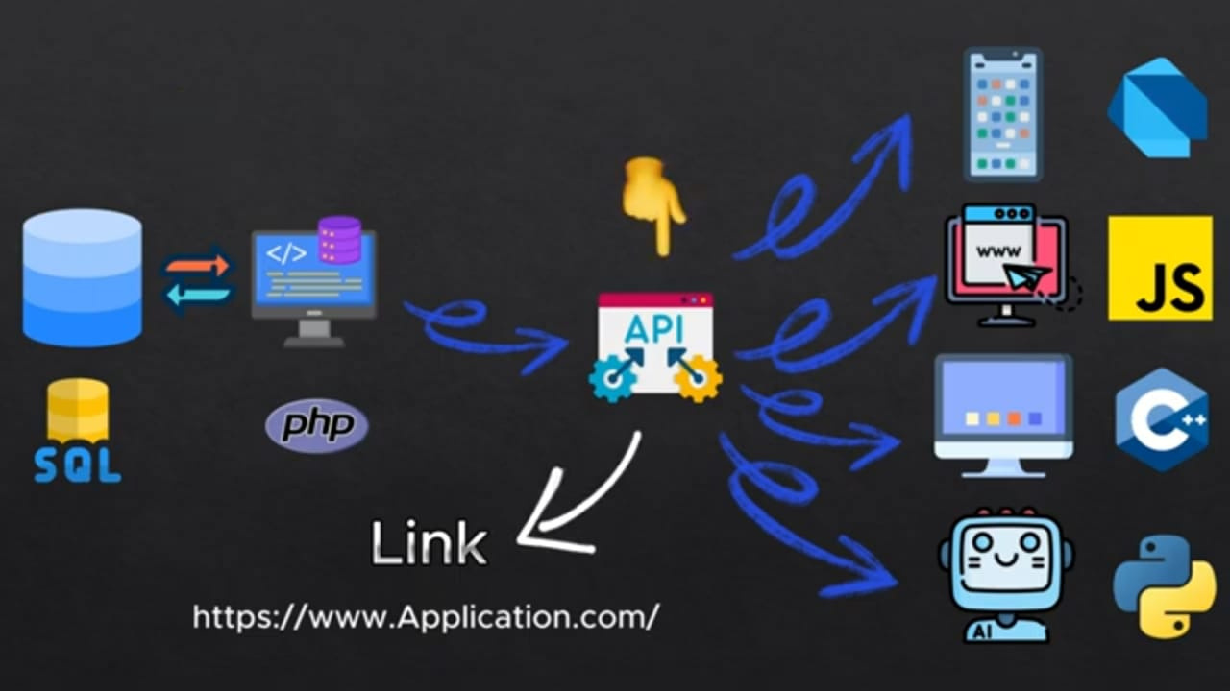

Slide 4
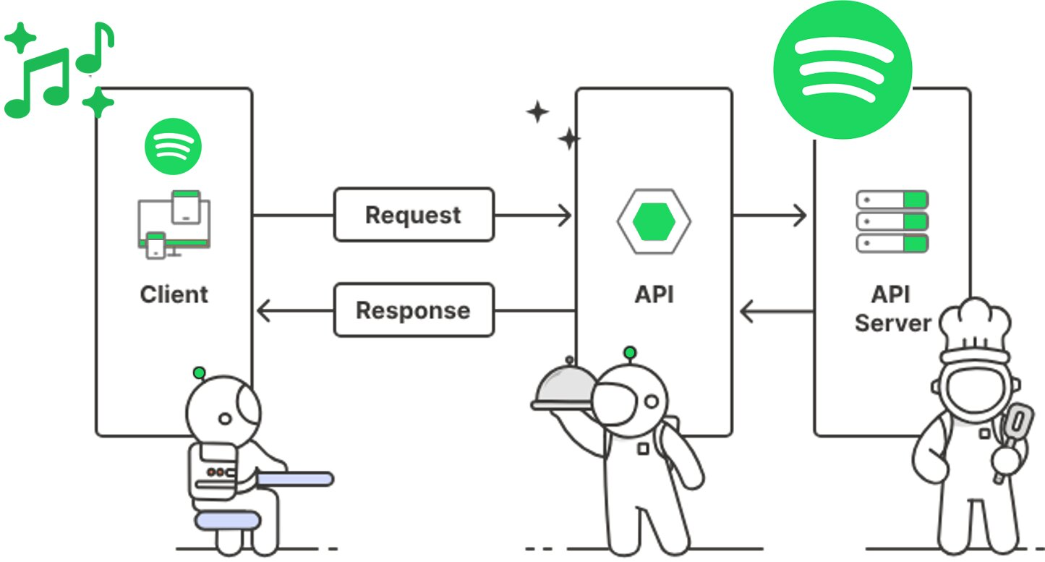

Slide 5
https://www.app.com
/users
?name=tasneem
Base URL
End Point
Query Parameter
Body {
"name" : "tasneem"
"email" : "tasneem@gmail.com" }
Headers Accepted-Language: 'ar'

Slide 6
HTTP Requests
Get
Put
Post
Retrieve all Data
Replace Recourse or Create new one
Create new Recourse
Patch
Delete
Partial Modification
Delete Data

Slide 7

API Testing Tool

Slide 8
Dio
Dio is a powerful HTTP client for Dart. Dio is easy to use, simple to handle and has better error handling.

Slide 9
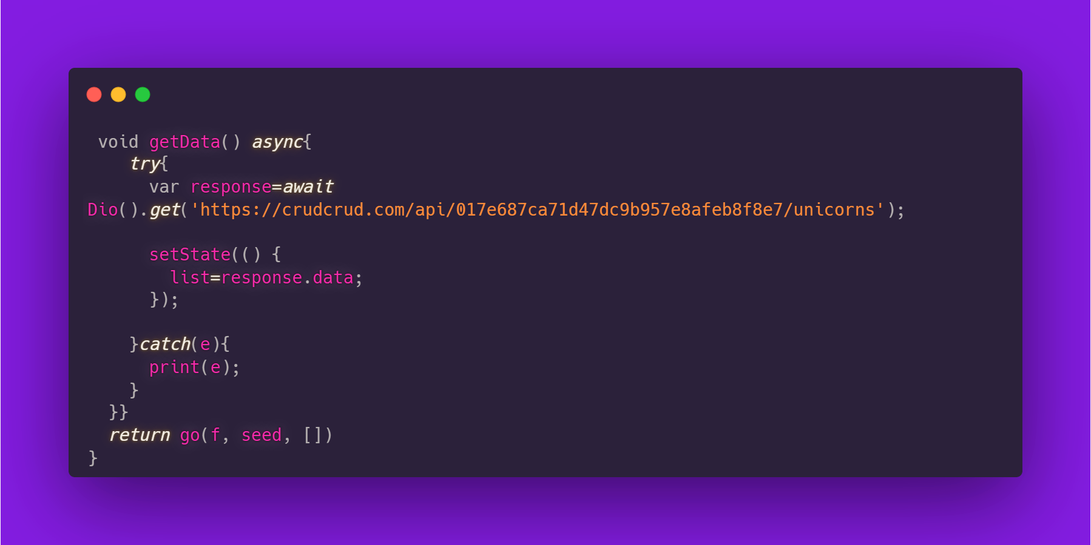
Using Dio

Slide 10
What about the rest of the functions?

Slide 11
Thank you!

